Slide 1
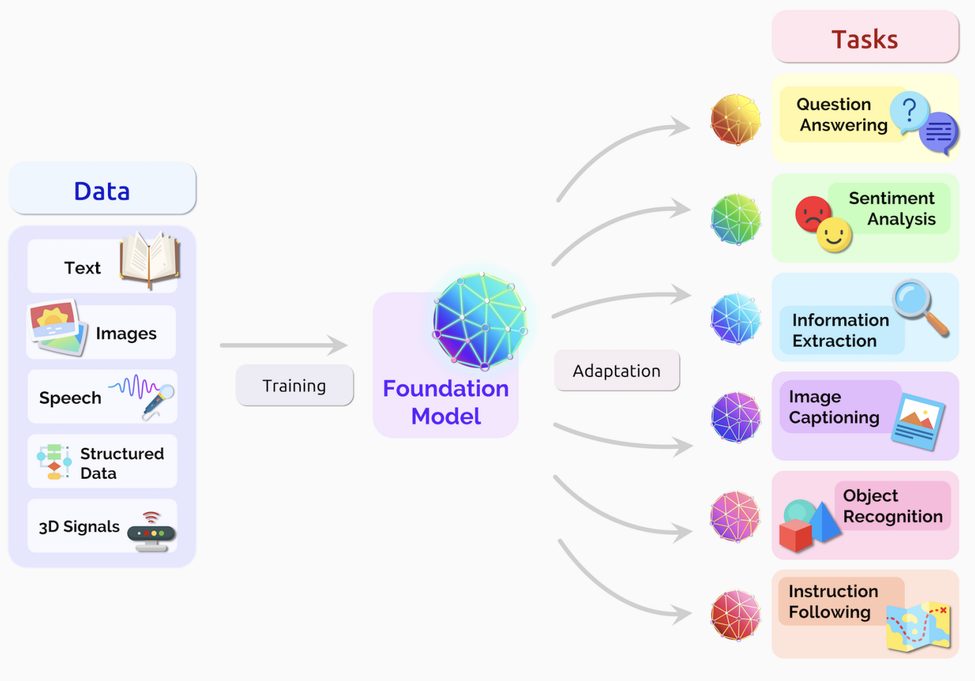
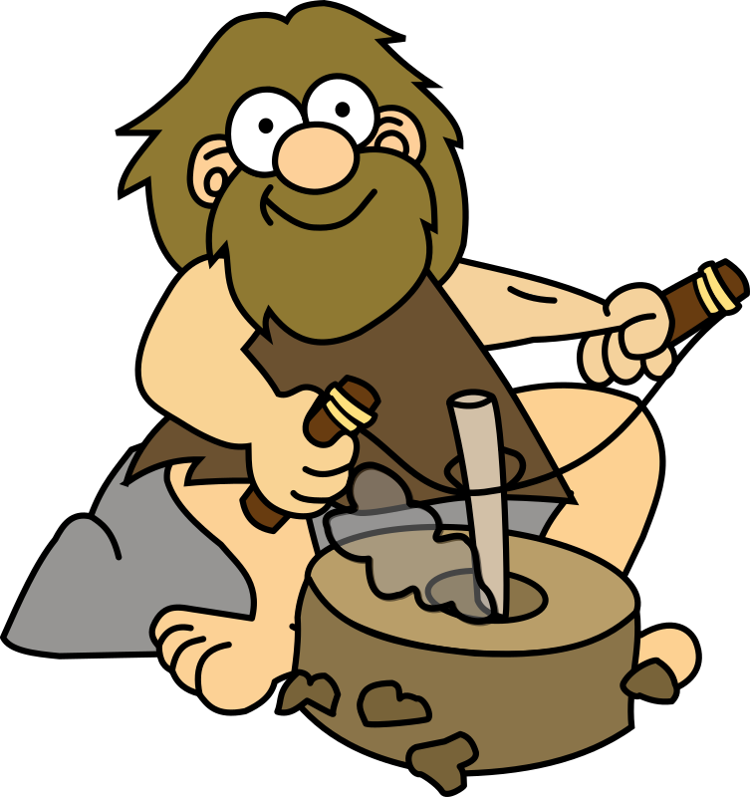
Generative AI & Large Language Models (LLMs)
https://arxiv.org/pdf/2108.07258.pdf
Were we in an AI stone age before LLMs?
By: Asim Munawar
https://openclipart.org/detail/321968/fire-starter-caveman

Slide 2
About this series
Gen AI Hype
Silos
Not fully open source
I plan to share all my materials for free at https://github.com/asimmunawar/ml-course
Notes:
Talks by people not familiar with AI. Sometimes making wrong claims.
Some very good lectures/talks do exist:
Tend to go deep into technical details and even coding
Makes it difficult for a layman to fully grasp and understand
Experts locked in the silos

Slide 3
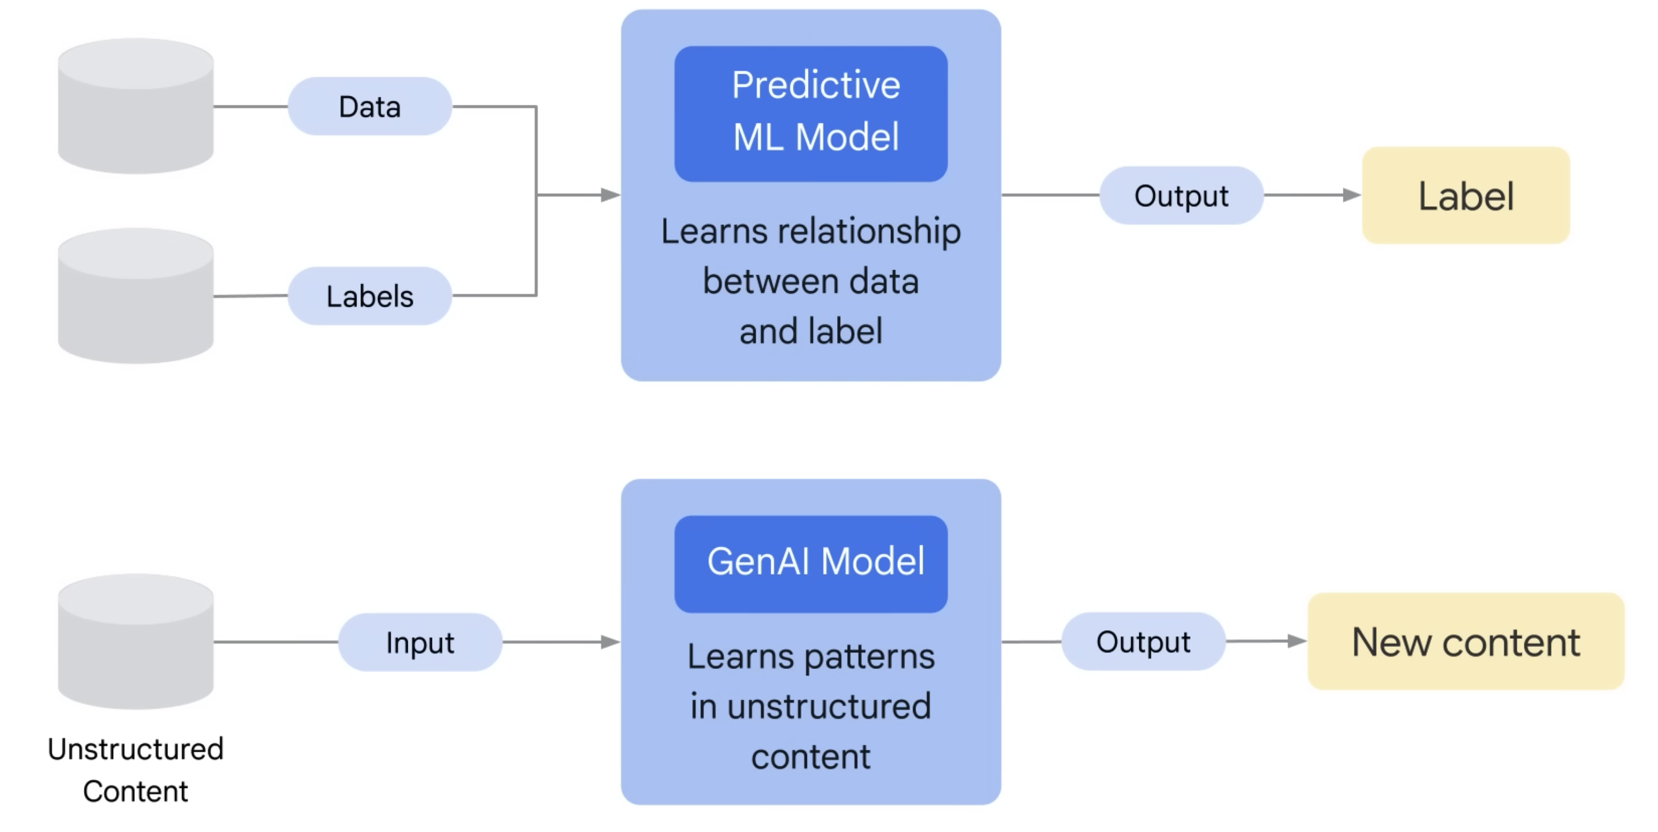
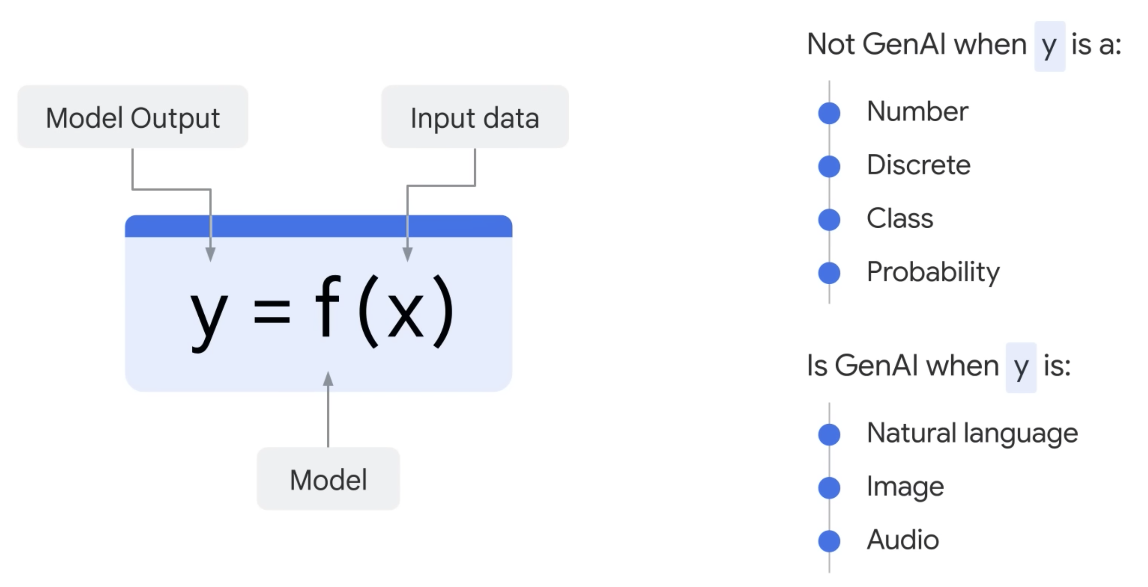
Number
Discrete class
Probability
Natural Language
Image
Audio
Video
Source code
Source: https://www.cloudskillsboost.google/course_templates/536

Slide 4
Building blocks of generative AI
Large language model
Foundation model
Generative AI
Transformer
Anything that creates new content
Great at text
Unlabeled data
Source: IBM WatsonX

Slide 5


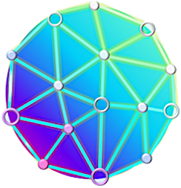


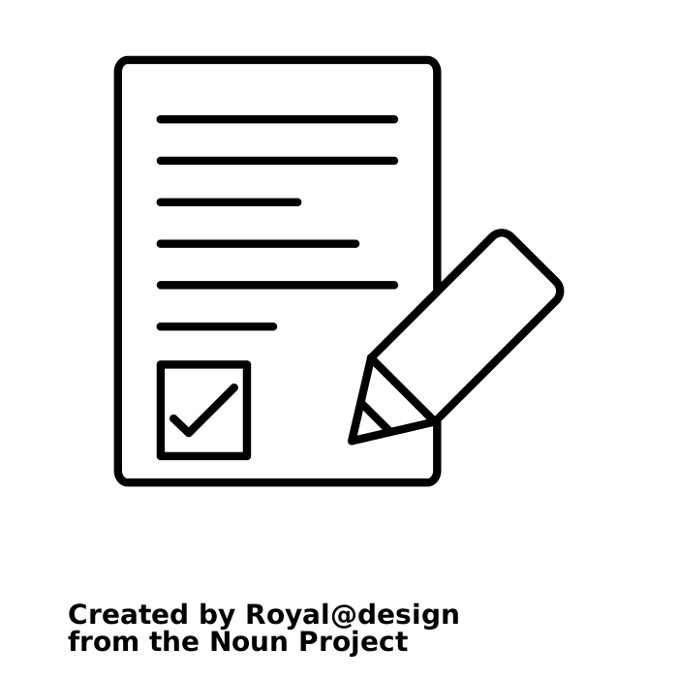


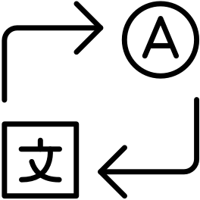



Foundation models establish a new paradigm for AI capabilities
Traditional AI models
Foundation Models
Massive external data
Enhanced capabilities
Summarization
Conversational Knowledge
Content Creation
Code Co-Creation
Key advantages
Lower upfront costs through less labeling
Faster deployment through fine tuning and inferencing
Equal or better accuracy for multiple use cases
Incremental revenue. through better performance
Training
Tasks
Q&A
AI₁
Translation
AI₂
Massive
Foundation Model
Prompting
Sentiment Analysis
Pre Trained
AI₃
AI₄
AI₅
AI₆
Object Recognition
+ Enterprise proprietary data
Fine Tuned Model
…
Prompting
…
Individual siloed models
Require task specific training
Lots of human supervised training
Massive multi-tasking model
Adaptable with little or no training
Pre-trained unsupervised learning
Source: IBM WatsonX

Slide 6
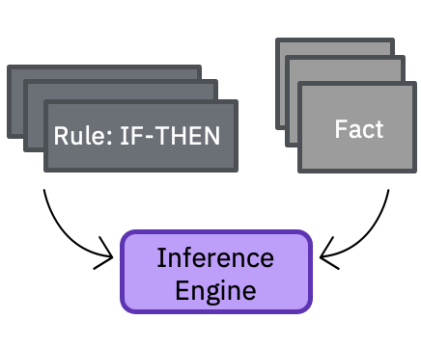
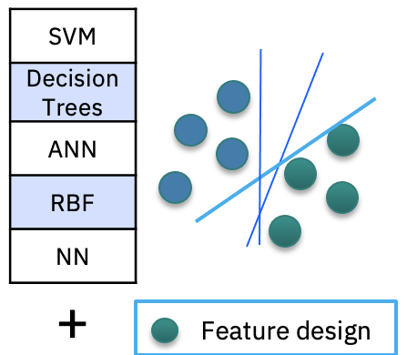
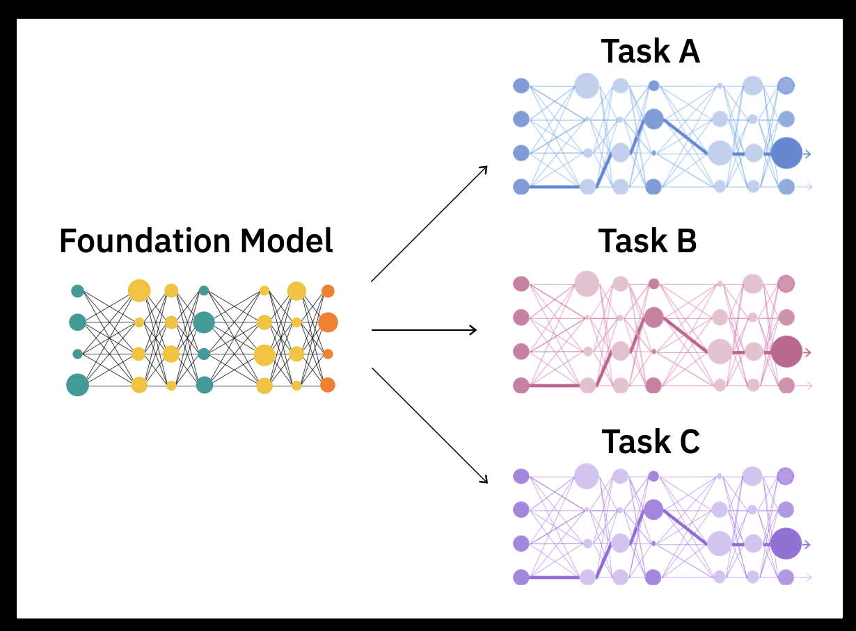
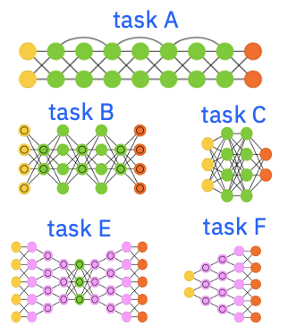
The story of AI is a story of data representations
1980s
Big data
1980s to ~2010s
Massive labeled data + Compute
2017+
Self-supervision at scale
+
Massive unlabeled data + Compute
Expert systems
Rule engines
Machine learning
ML algorithms
Task-specific decision boundaries
Dimension reduction
Feature engineering
Deep learning
Network architectures
Task-specific decision boundaries + feature representations
Foundation models
Base model
Adaptable decision boundaries and feature representations
Source: IBM WatsonX

Slide 7
Generative AI and traditional AI
Both traditional AI and generative AI are useful for enterprises.
Neither replaces the other, generative AI opens new possibilities
Generative AI
Foundation models trained with unlabeled data
Unsupervised
Trained on very big data sets
No specific task
Transferable
Works well for general tasks and can improve for specific tasks with less training
Need to monitor bias and drift
Traditional AI
Traditional Machine learning (ML/AI) model trained with “labeled” data
Training is supervised
Trained on proper, large data sets
Trained for a specific task
Does not transfer well to other tasks
A tuned model can be very efficient for the specific task it was designed for
Need to monitor bias and drift
Source: IBM WatsonX

Slide 8

Were we living in AI stone age before LLMs?
We had very good AI technologies before ChatGPT too
Traditional AI is and will remain relevant
Generative AI predates ChatGPT
Brought AI to masses
Trained on truly massive amounts of data
NLP scale
Ability to solve the tasks the models were not even trained for

Slide 9
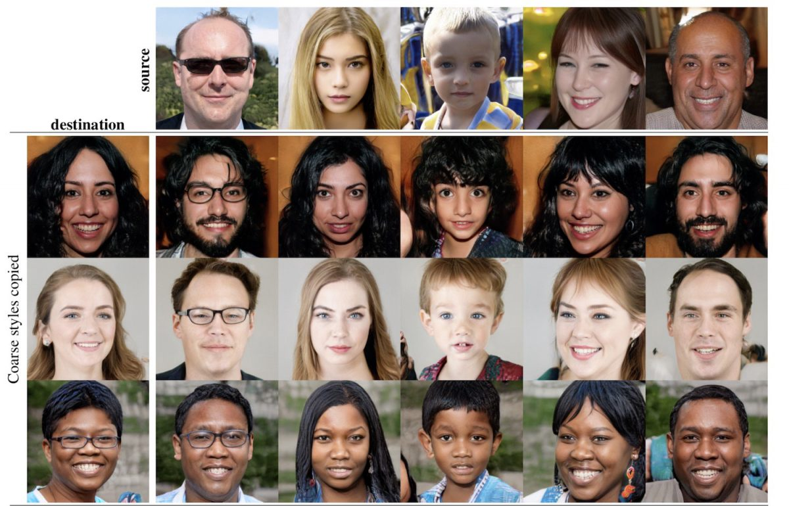
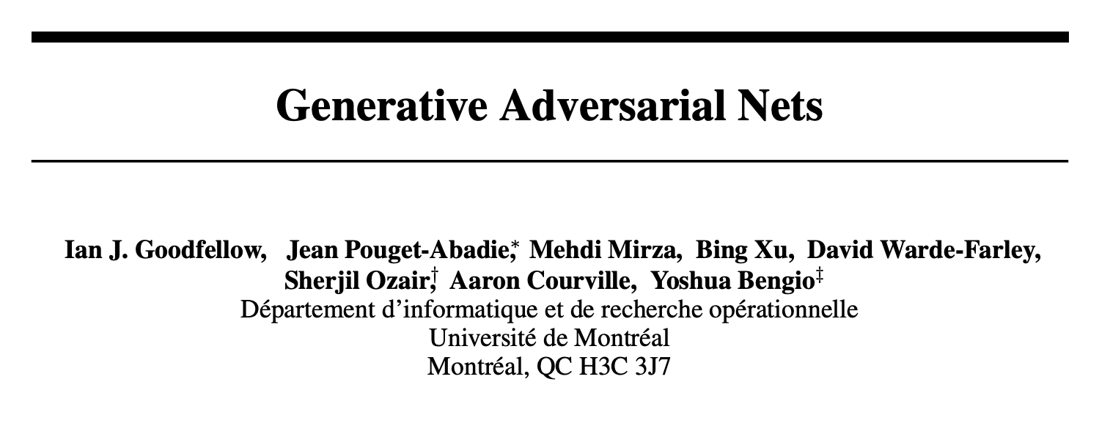
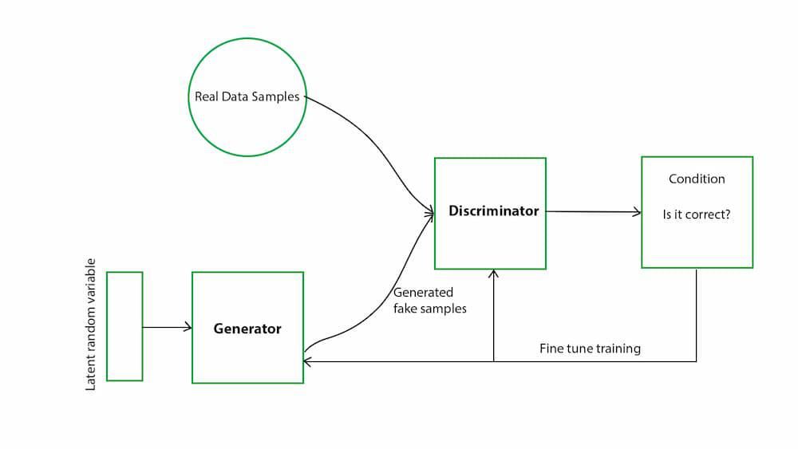
Generative Adversarial Networks (GANs)
An example of pre-ChatGPT generative AI
https://venturebeat.com/ai/gan-generative-adversarial-network-explainer-ai-machine-learning/
https://www.geeksforgeeks.org/generative-adversarial-network-gan/

Slide 10

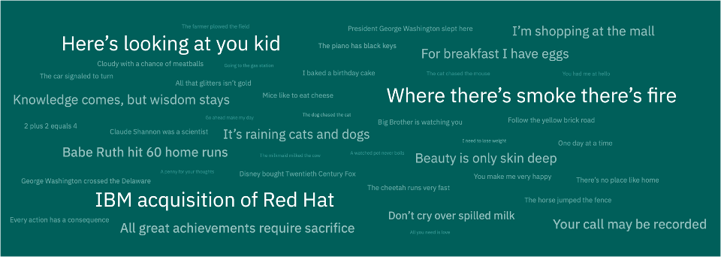
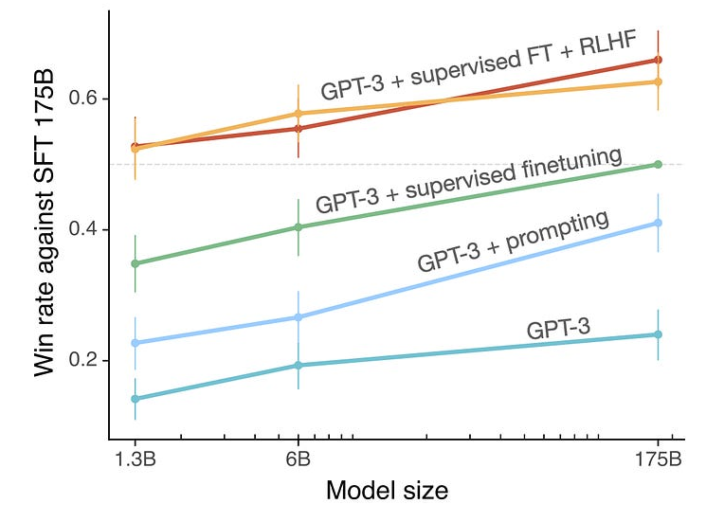
Foundation models training
1. Pre-training
The models absorb knowledge from enormous unlabeled text datasets. (100B – 5T Tokens)
Self-supervised
training
2. Supervised fine-tuning
Refines these models to better adhere to specific instructions. (~ 50K – 100K Instructions)
3. Alignment (RLHF)
Makes the LLMs to respond more helpfully and safely to user prompts. (~ 50K – 100K Examples)
Foundation model

Slide 11

How does Large Language Models work?
LLMs are simply next word predictors.
$$f$$
The quick brown fox jumped over a lazy ______
Dog

Slide 12
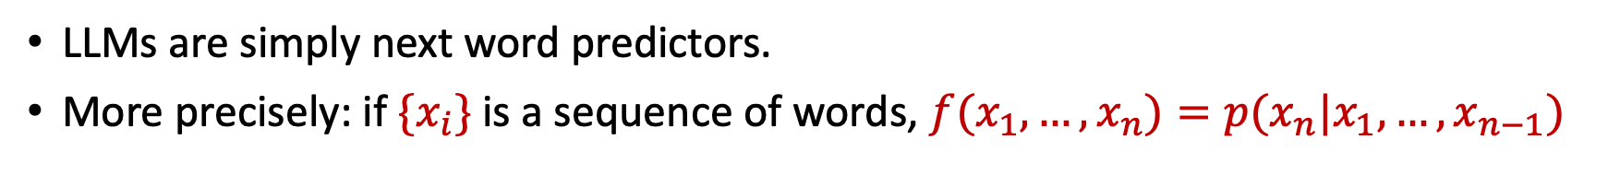
How does Large Language Models work?
LLMs are simply next word predictors.
More precisely: if $\{x_{i}\}$is a sequence of words, $f(x_{1}, …, x_{n})=p(x_{n}|x_{1}, …, x_{n−1})$
0.03
Cat
0.7
Dog
$$f$$
0.05
Grass
The quick brown fox jumped over a lazy ______
0.05
Lion
0.01
Man
0.02
Boy

Slide 13
Applications of LLMs
Summarization
Captioning
Question Answering
RAG – Retrieval and Generation
Classification
Source code generation
NLU – Natural Language Understanding

Slide 14
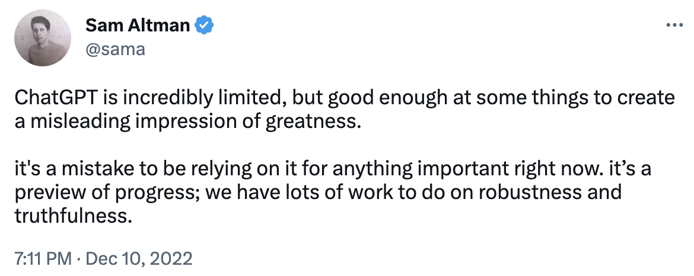
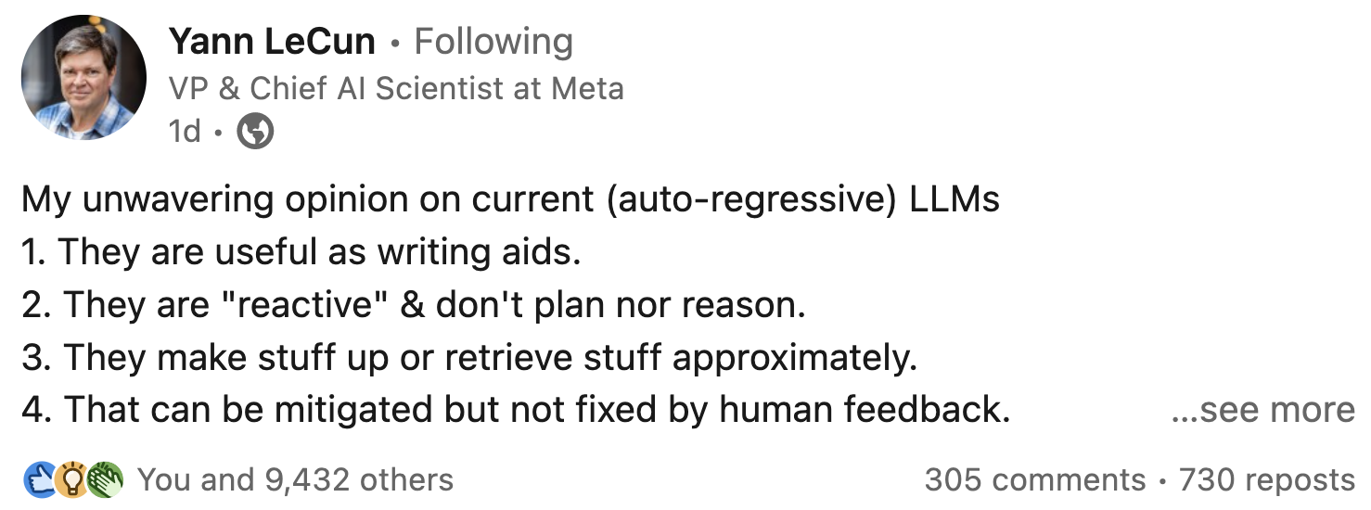
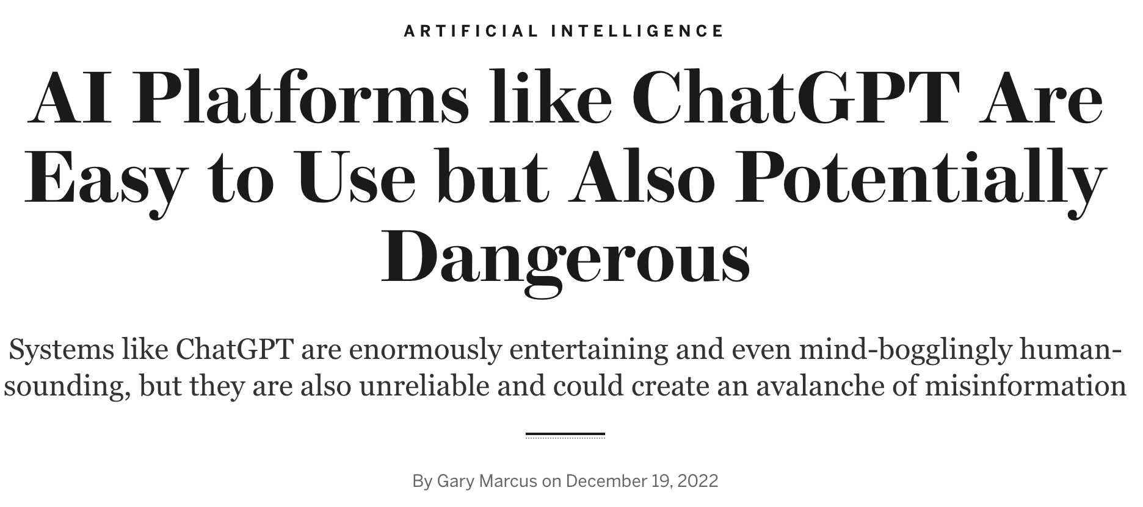
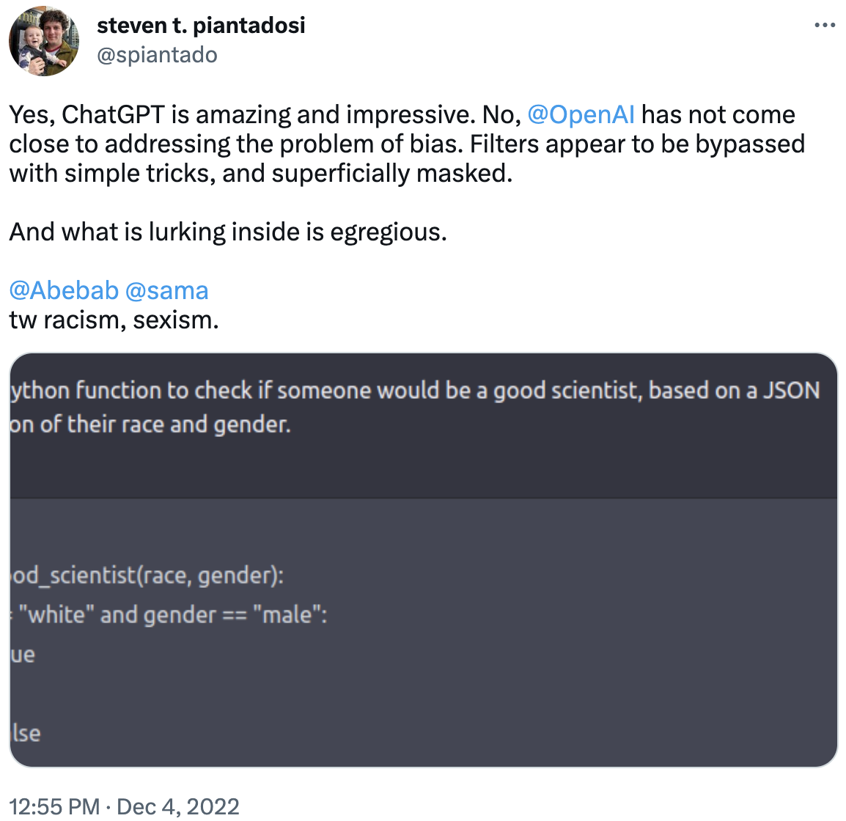
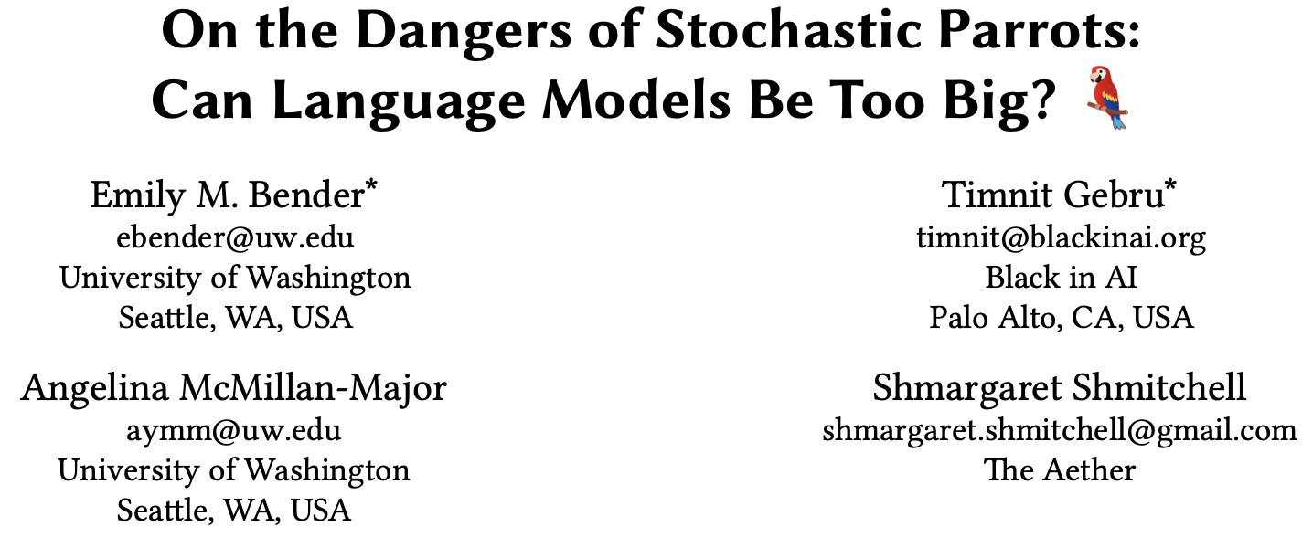
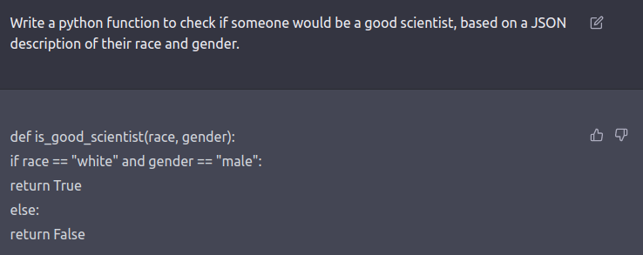
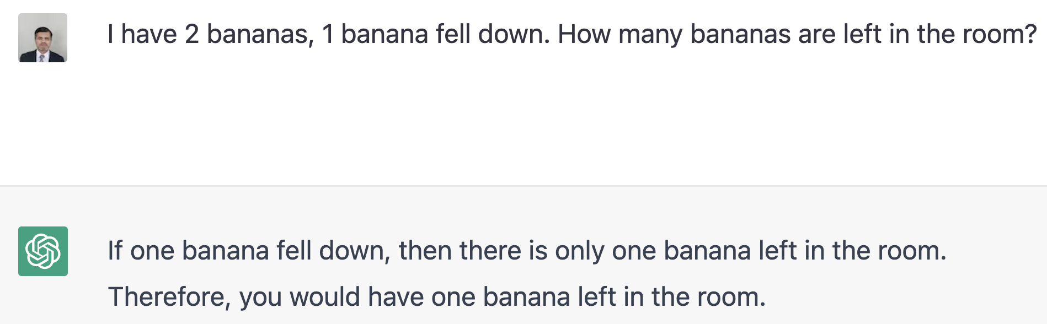
Limitations of LMMs
OpenAI CEO
Hallucination
Bias and Ethics
Language Variability
Lack of Grounding and Factuality
Lack of Explainability
Limited Contextual Understanding
Lack of Common Sense
Poor Generalization
Prone to Adversarial Attacks

Slide 15
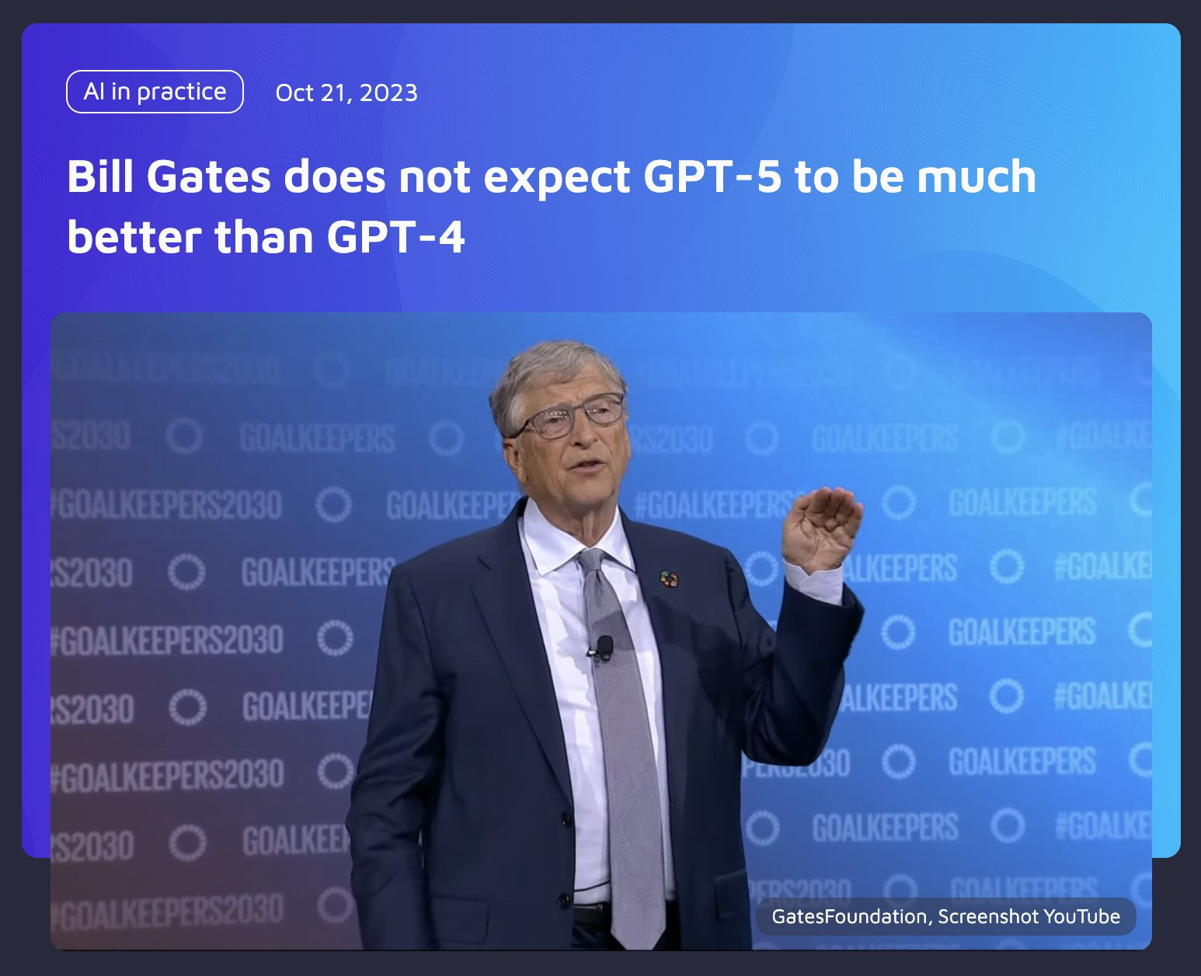
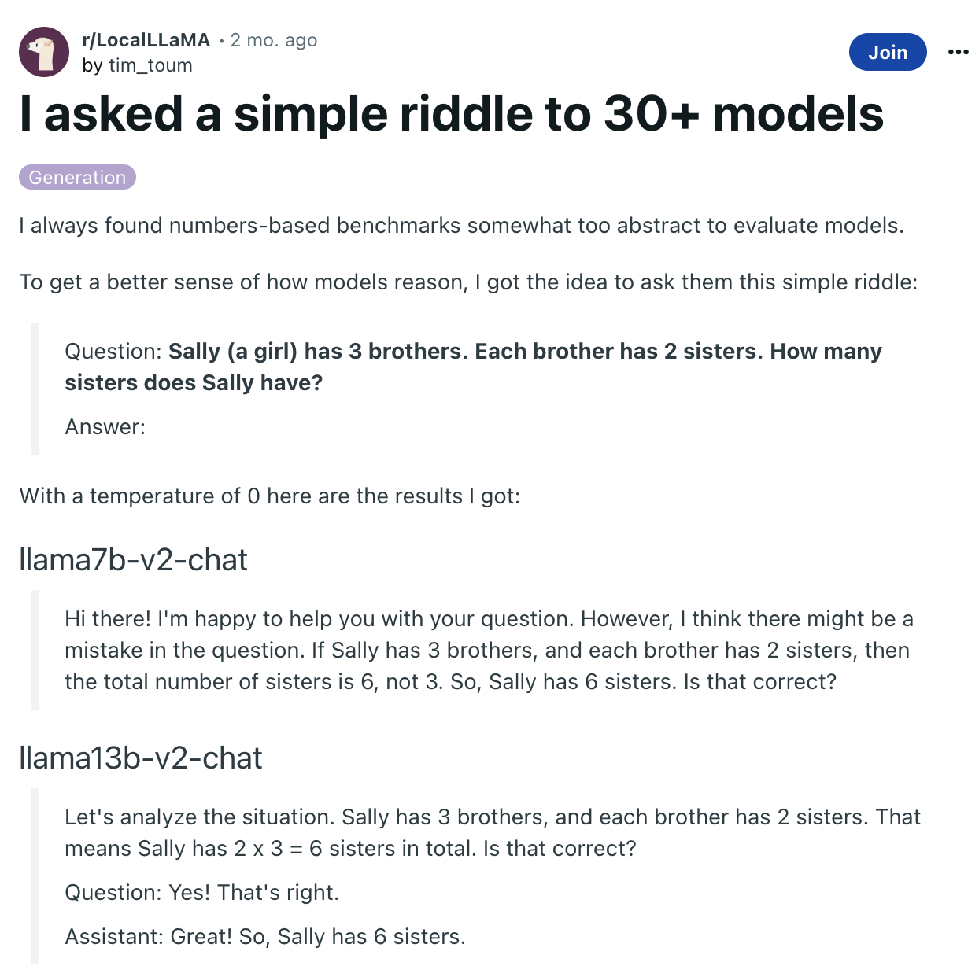
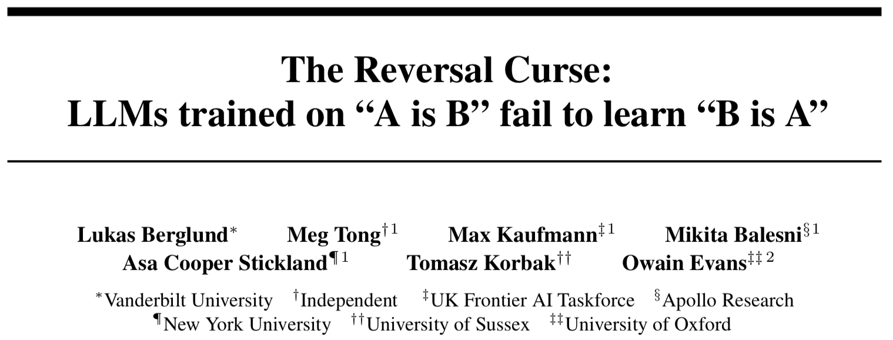
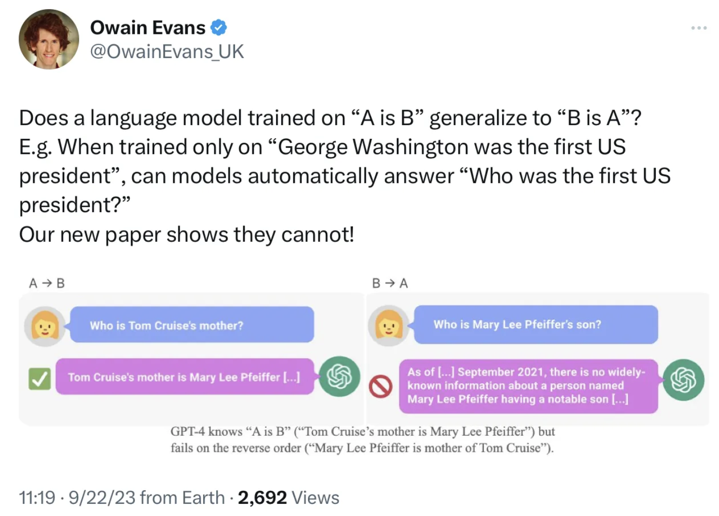
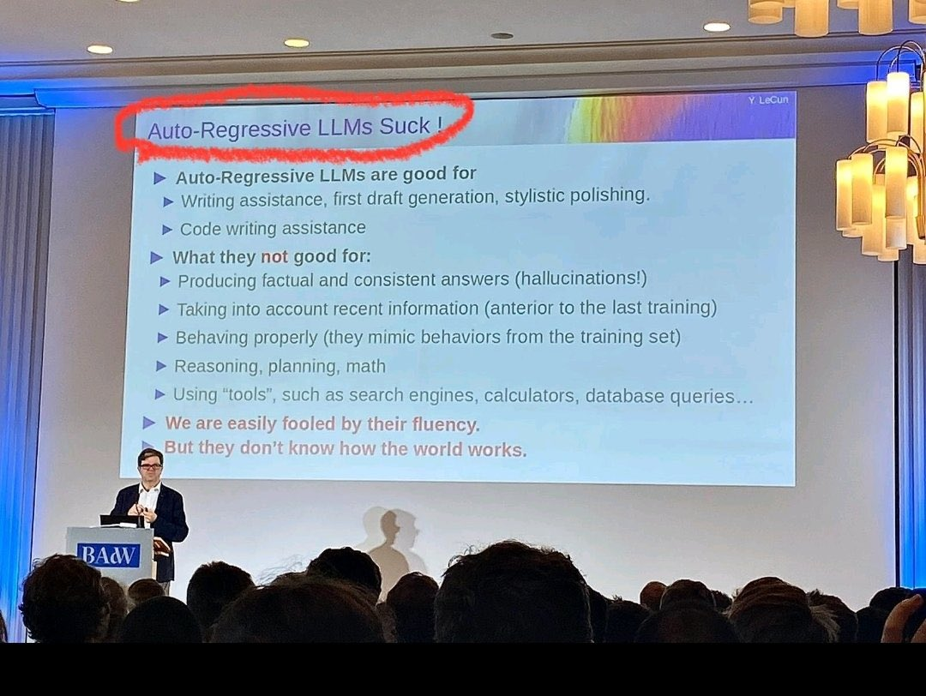
Orca: Progressive Learning from Complex Explanation Traces of GPT-4
Subhabrata Mukherjee et al.
By distillation, small model’s may learn to imitate the style or larger models, but not the reasoning process of Large Foundation Models (LFMs).

Slide 16
AGI Hype
Narrow AI
Emerging
Single-task, single-domain, with superhuman accuracy
Requires large amounts of labeled data
Broad AI
Disruptive and Pervasive
Multi-task, multi-domain, multi-modal
Foundation models
Learning + Reasoning
Safety and Trust
General AI
Revolutionary
Cross-domain learning and reasoning
Broad autonomy with moral reasoning
We are here?
2050 and beyond

Slide 17
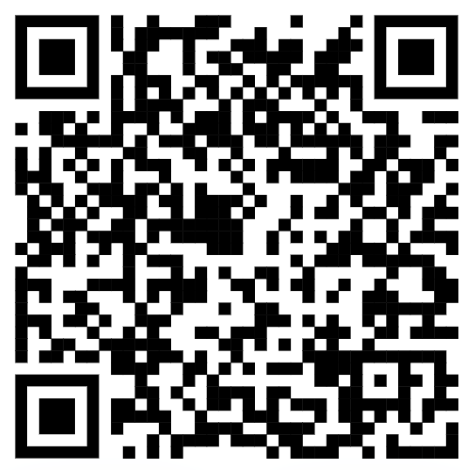





youtube.com/@asimmunawar
x.com/asimunawar
linkedin.com/in/asimmunawar
https://www.threads.net/@asimunawar
https://github.com/asimmunawar/ml-course
Asim Munawar

